Slide 1
515-50-B-2021/Summer
Final project
Aug, 7 2021
Team:
Saurav Mawandia
Sougandh Kohli

Slide 2






Portfolio description
For our project we have included :
Financial Services - JP Morgan (JPM), Goldman Sachs (GS)
Utilities- DTE energy co(DTE) and AES corp.(AES)
Tech: Amazon(AMZN) and Apple(AAPL)
Time period for our project was July 2012- July 2021, but for the purpose of this project, we only focussed on July 2019-July 2021, capturing the Pandemic effects on our stocks.
Source: All the data has been sourced from yahoo finance and US Dept. of Treasury

Slide 3
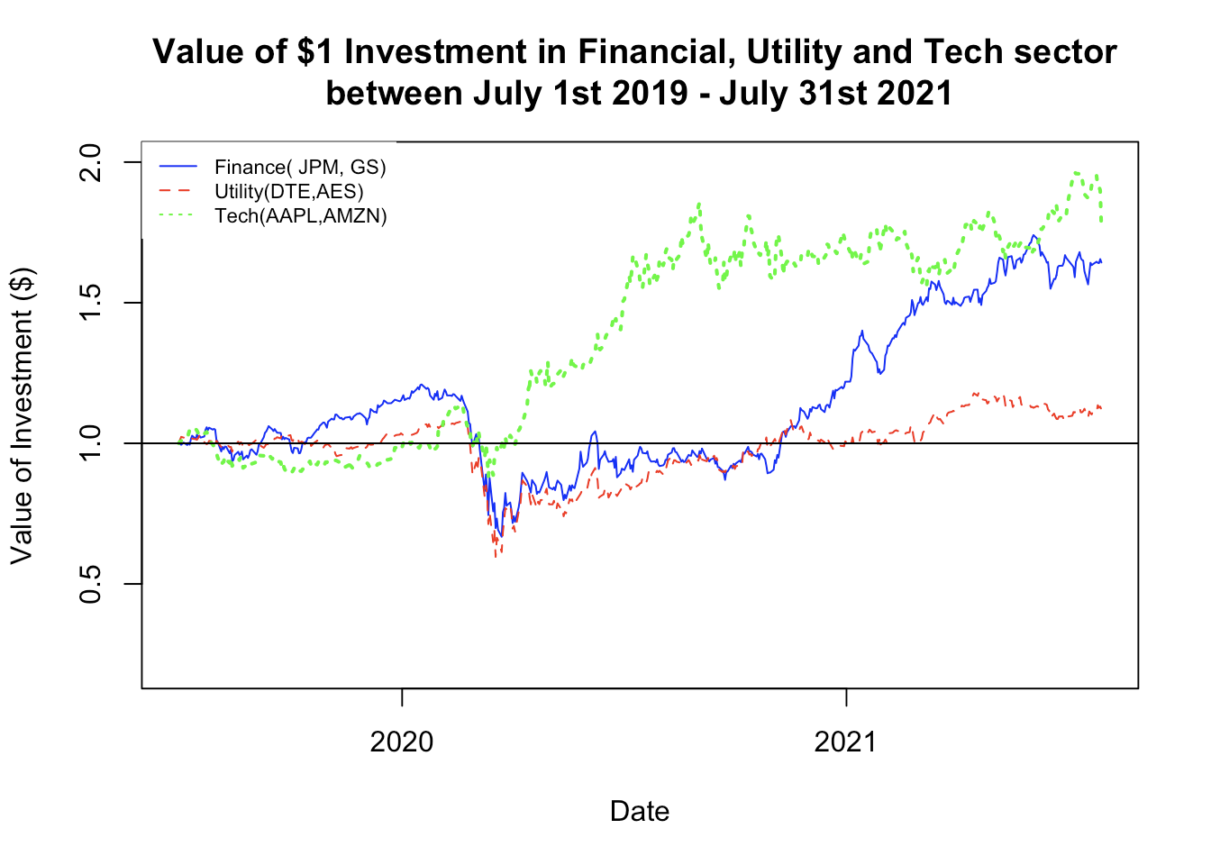
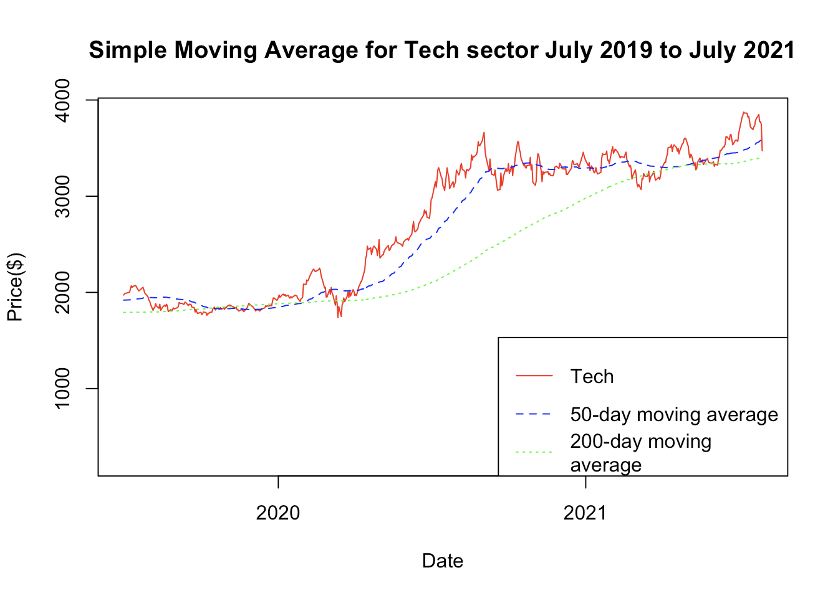
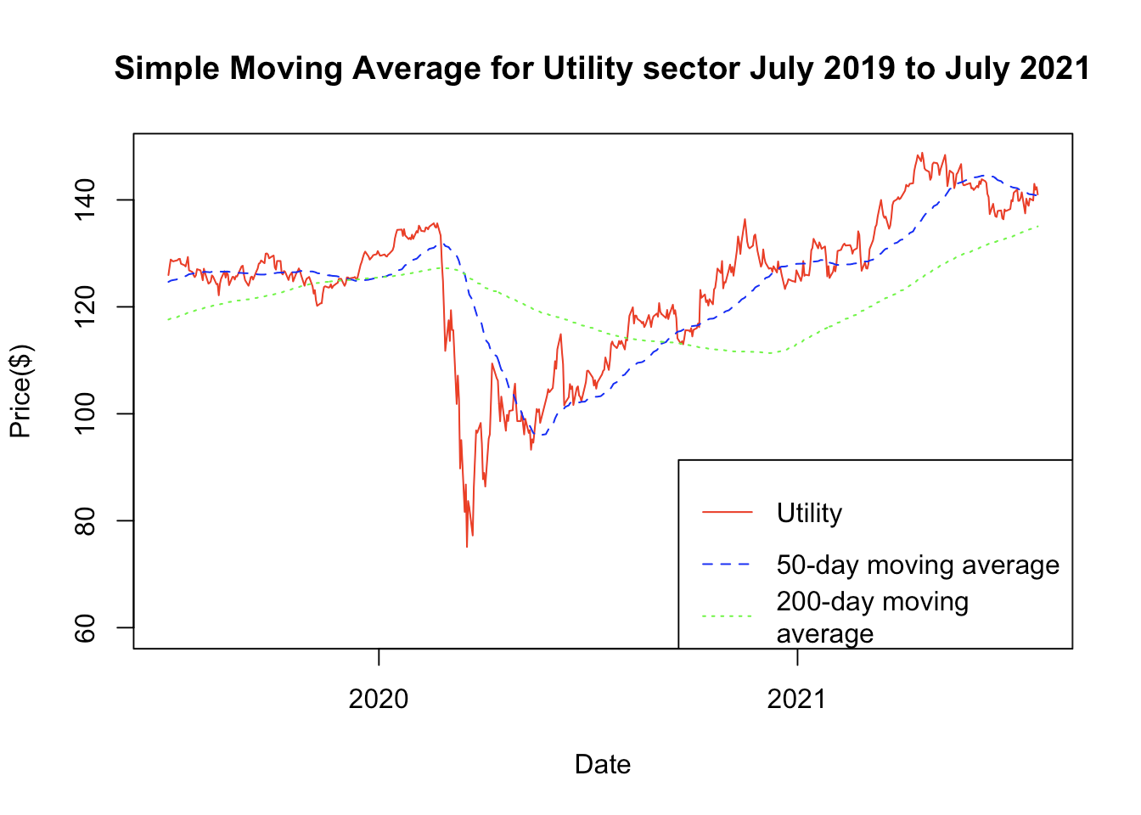
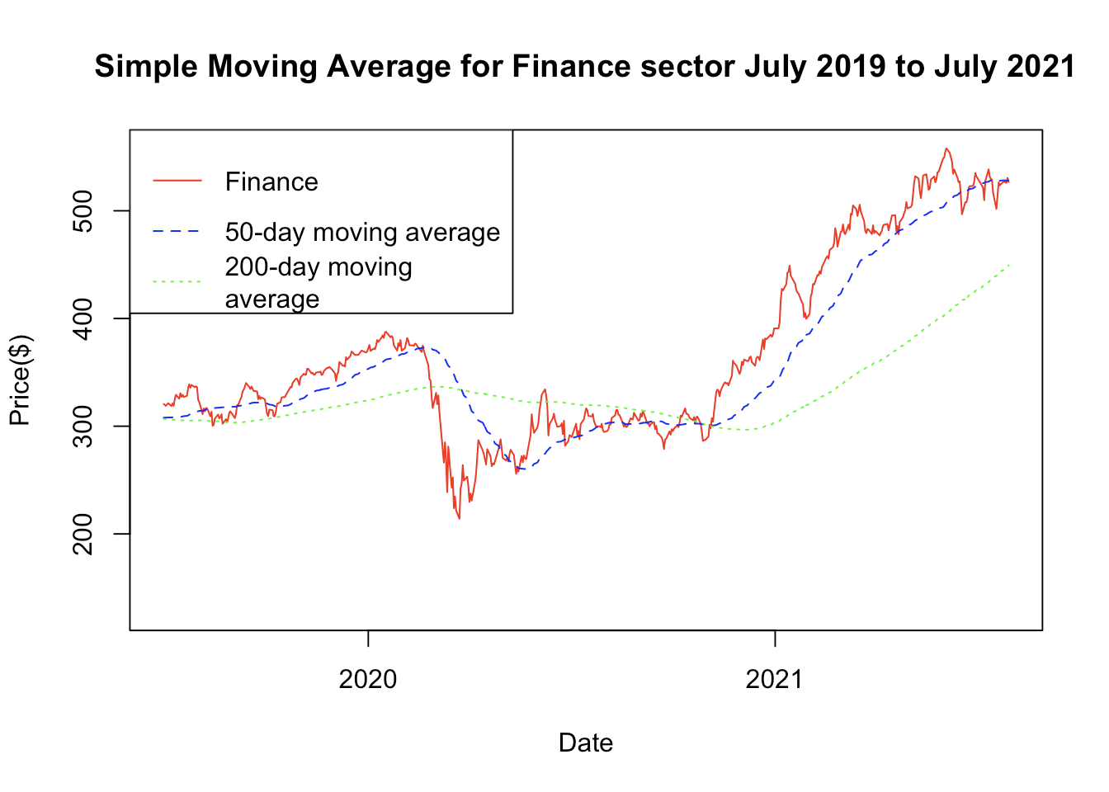
Data visualization
The first plot highlights the performance of $1 investment done at the start of the observation period
The three plots below are the simple moving average for all the three sectors under consideration for our project.

Slide 4
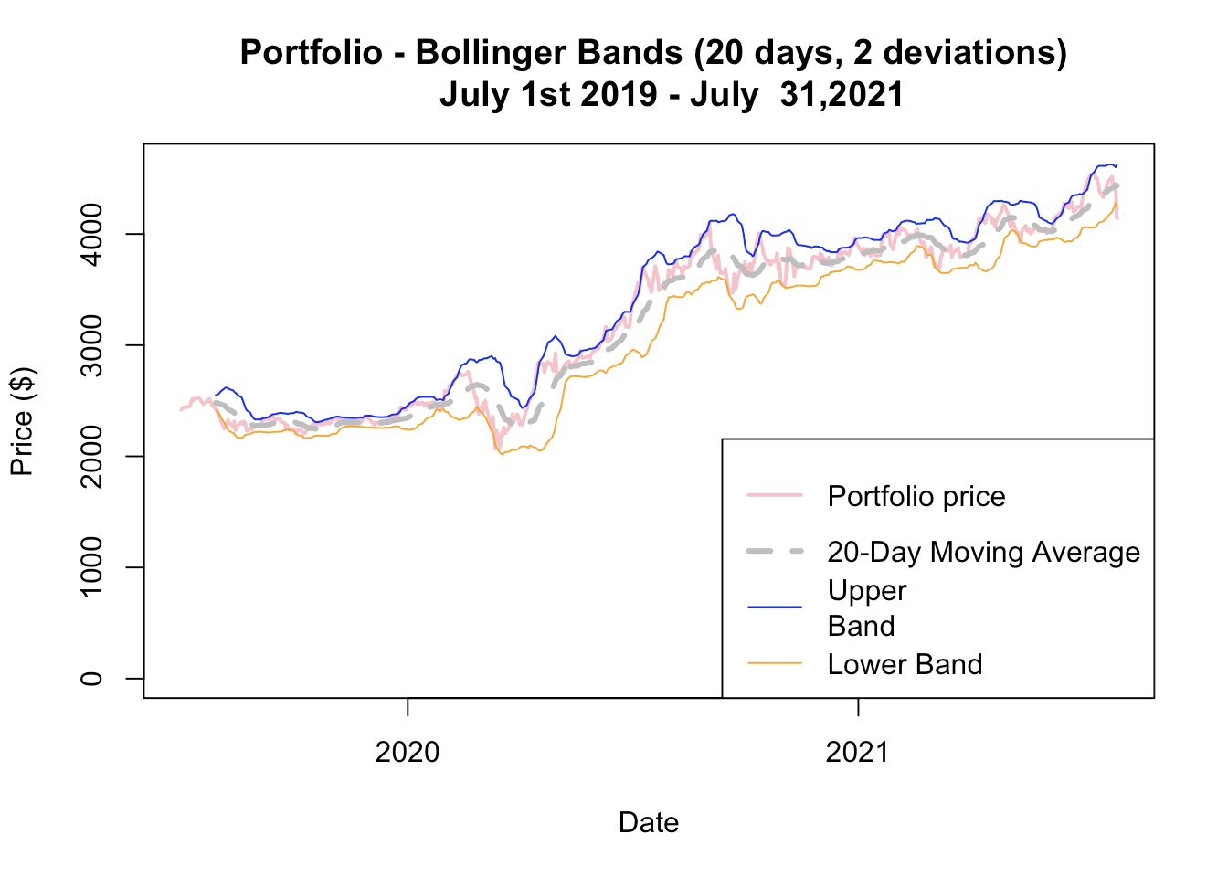
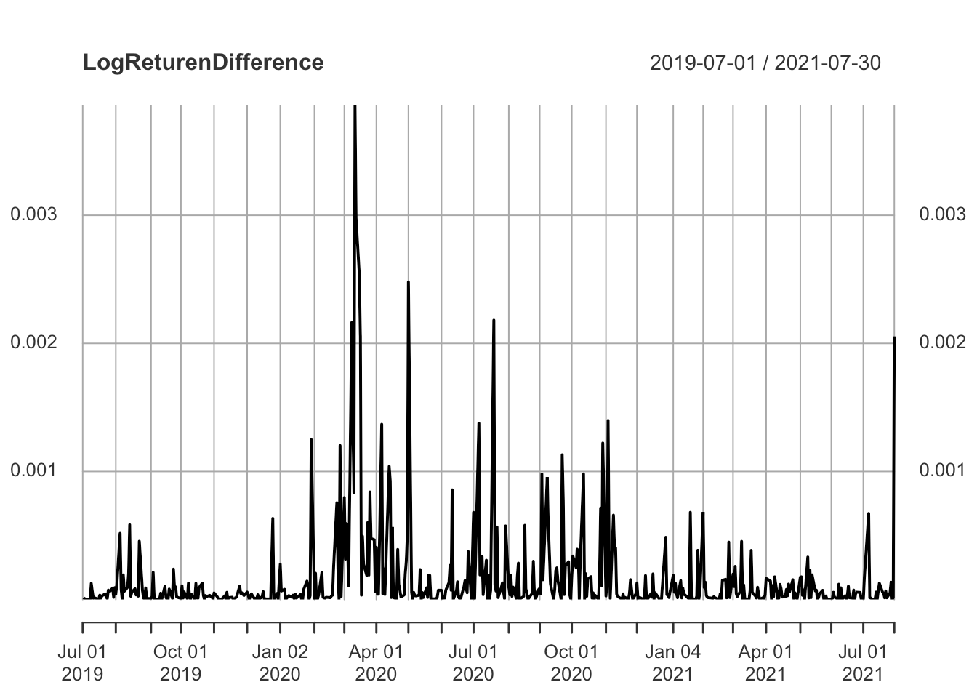
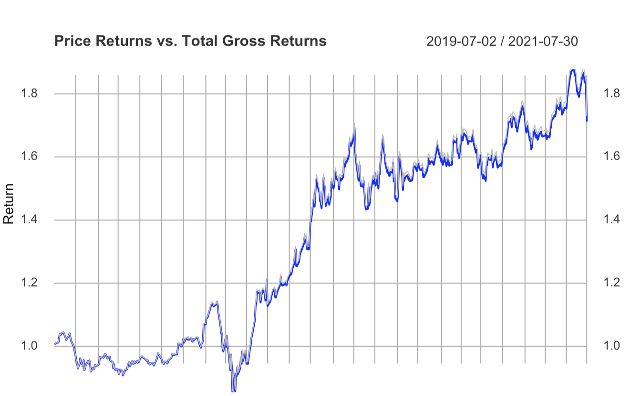
Data visualization
Bollinger band for our portfolio (simply considering closing price of all our stocks).
We also calculated log returns and plot highlighting how the price returns vs gross returns for our stocks is varying.

Slide 5
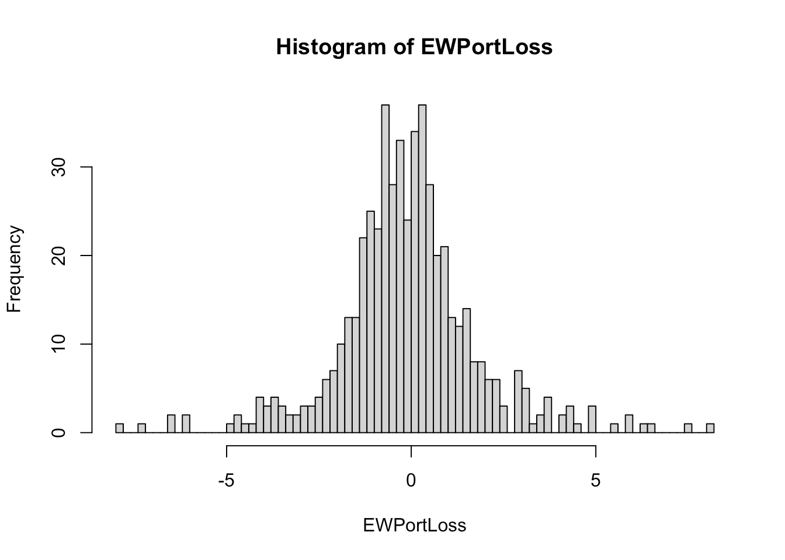
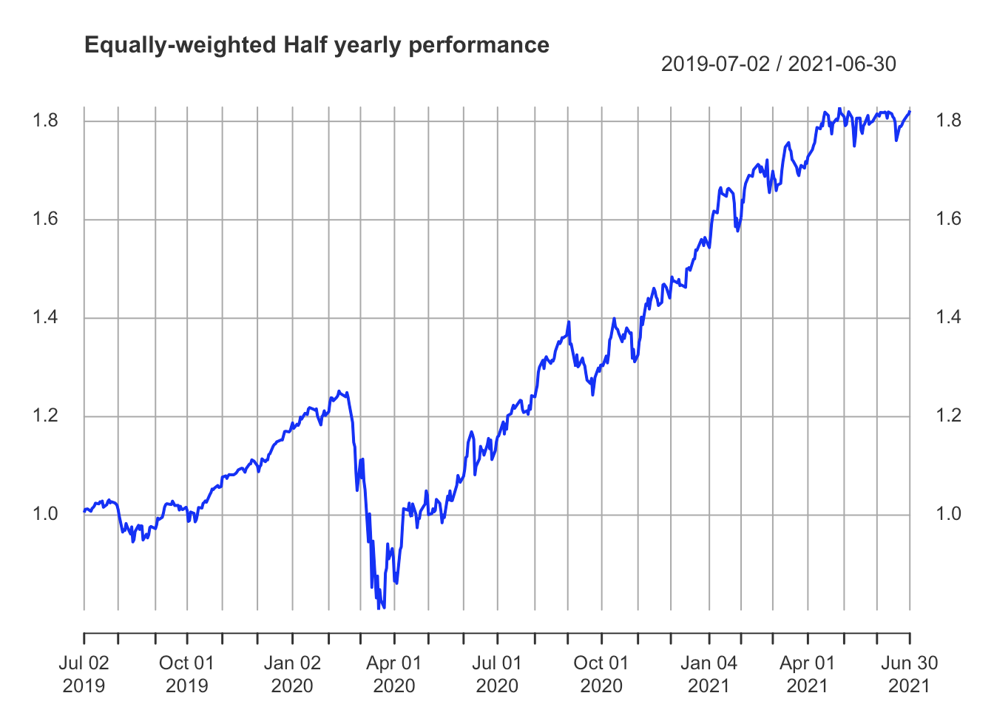
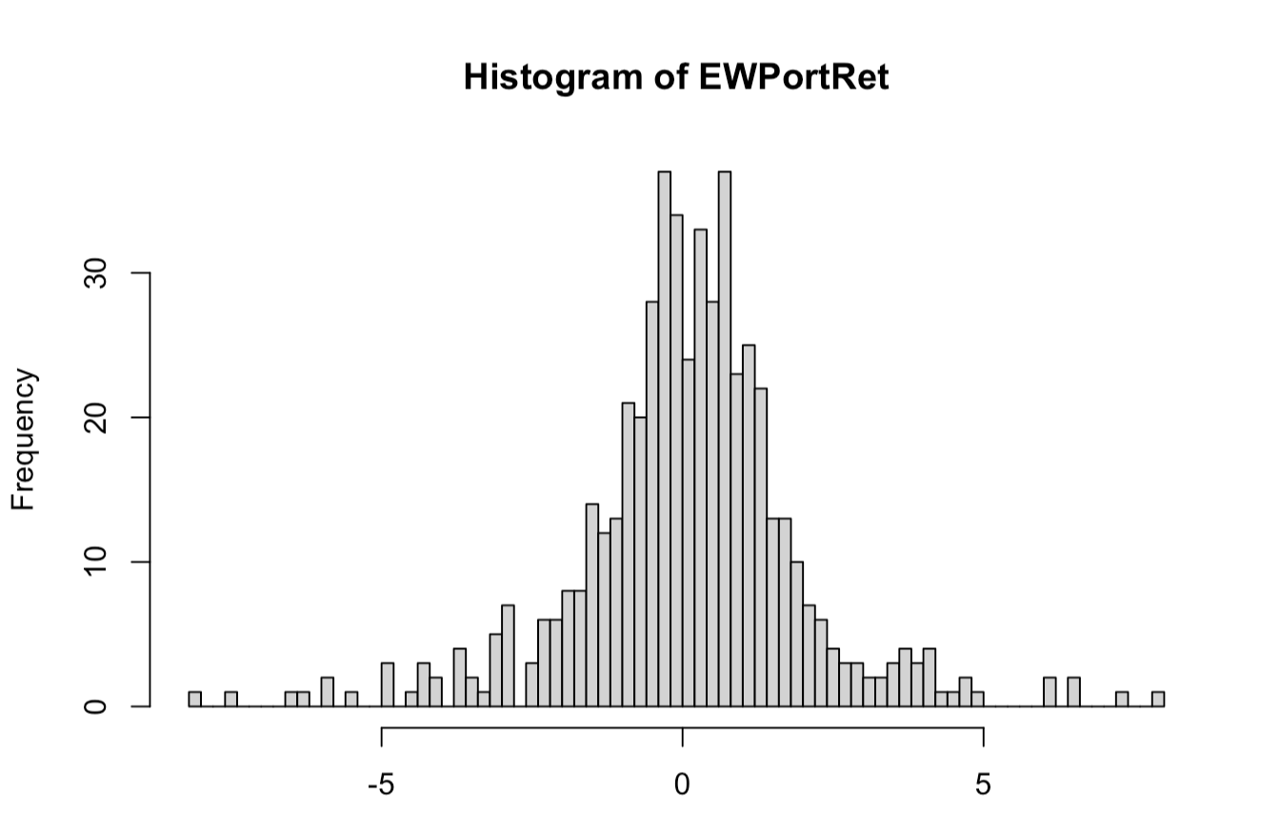
Creating a equally weighted portfolio
For this project, we have used an equally weighted portfolio and wanted to see if we give equal importance to value vs high return stocks, how our portfolio will perform.
Moreover, we have focussed on July 2019-July 2021 period, hence capturing portfolio performance half yearly in this period.
The histograms below show us the behaviour of portfolio returns and losses, that is we have normal behavior or not, and we can see multimodal distribution.

Slide 6
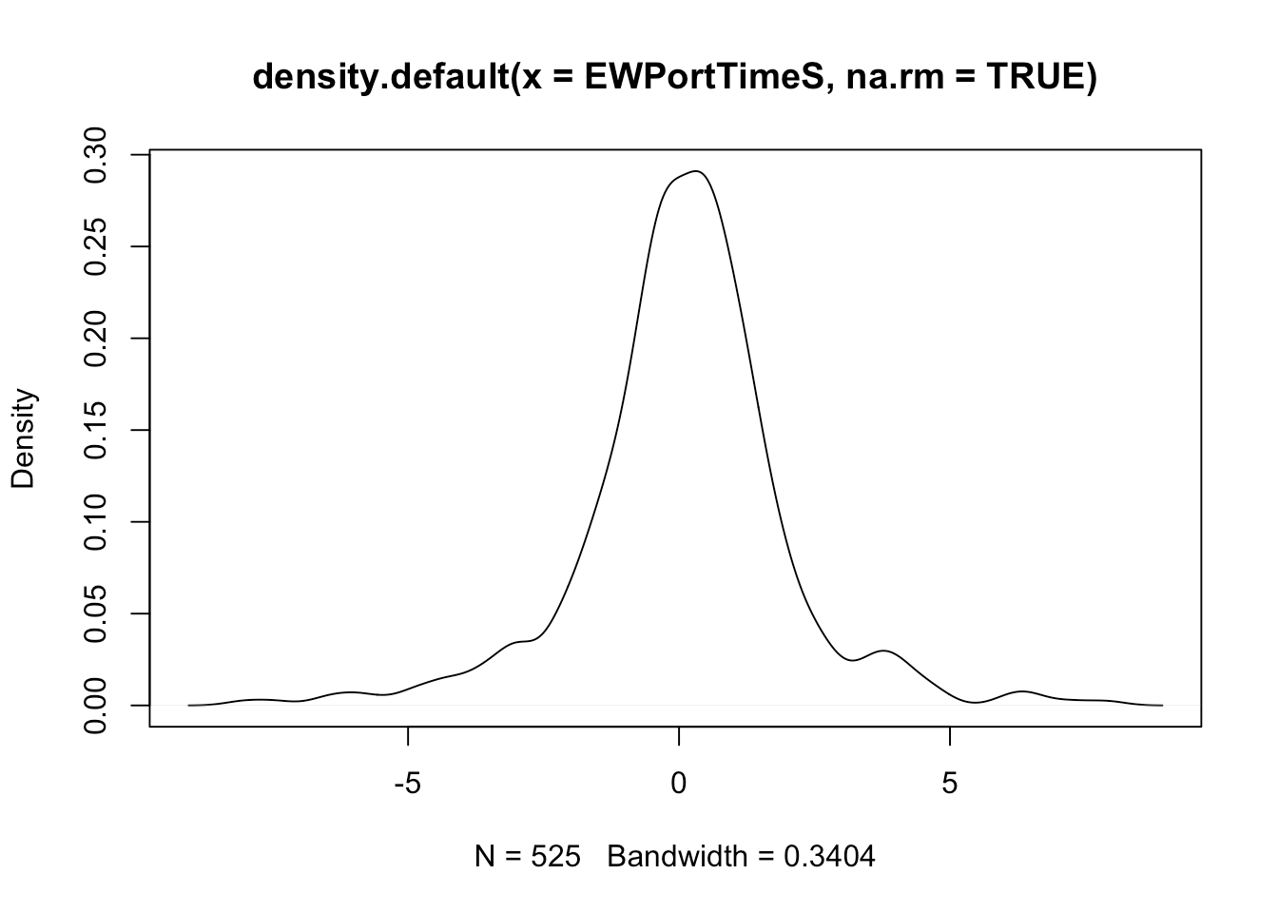
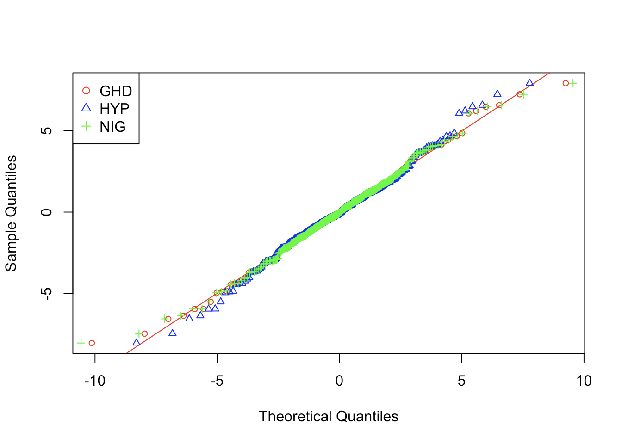
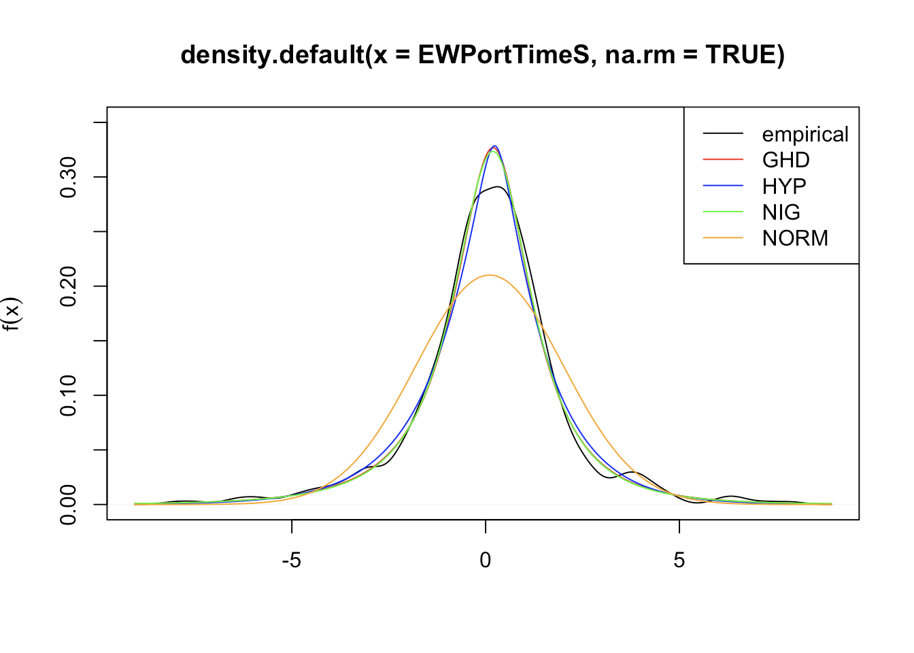
Distribution fitting
Before fitting any distribution on our portfolio returns, we plotted a density plot, to visualize the behavior of our returns.
We can clearly see that our data is leptokutic, that is more peaked than a normal distribution.
For distribution fitting, we have used the following three:
Genralized Hyperbolic Distribution(GHD)
Hyperbolic distribution
Normal Inverse Gaussian distribution

Slide 7
Best fit model
To find the best fit Model we use the function “lik.ratio.test” to perform a likelihood-ratio test on fitted generalized hyperbolic distribution. The likelihood-ratio test can be used to check whether a special case of the generalized hyperbolic distribution is the “true” underlying distribution.
If the p-value for the test (the p-value is less than 0.05, then there is evidence against the null hypothesis)
Results:
model symmetric lambda alpha.bar mu sigma gamma aic llh ## 8 NIG TRUE -0.50000 0.47277 0.15079 1.9311 0.00000 2069.0 -1031.5 ## 3 NIG## 6 ghyp## 1 ghyp## 10t## 7 hyp. TRUE 1.00000 0.26353 0.15048 1.8407 0.00000 2074.6 -1034.3 ## converged n.iter FALSE -0.50000 0.47592 0.21013 1.9263 -0.10686 2070.3 -1031.2 TRUE -0.26886 0.48899 0.15181 1.9200 0.00000 2070.9 -1031.4 FALSE -0.25085 0.49023 0.21364 1.9146 -0.11024 2072.1 -1031.0 TRUE -1.37365 0.00000 0.14747 2.2544 0.00000 2074.1 -1034.1 ## 8 TRUE 104 ## 3 TRUE 121 ## 6 TRUE 189 ## 1 TRUE 510 ## 10 TRUE 106 ## 7 TRUE 106 | ## $statistic ## L ## 0.90068 ## ## $p.value ## [1] 0.64738 ## ## $df ## [1] 1 ## ## $H0 ## [1] TRUE

Slide 8
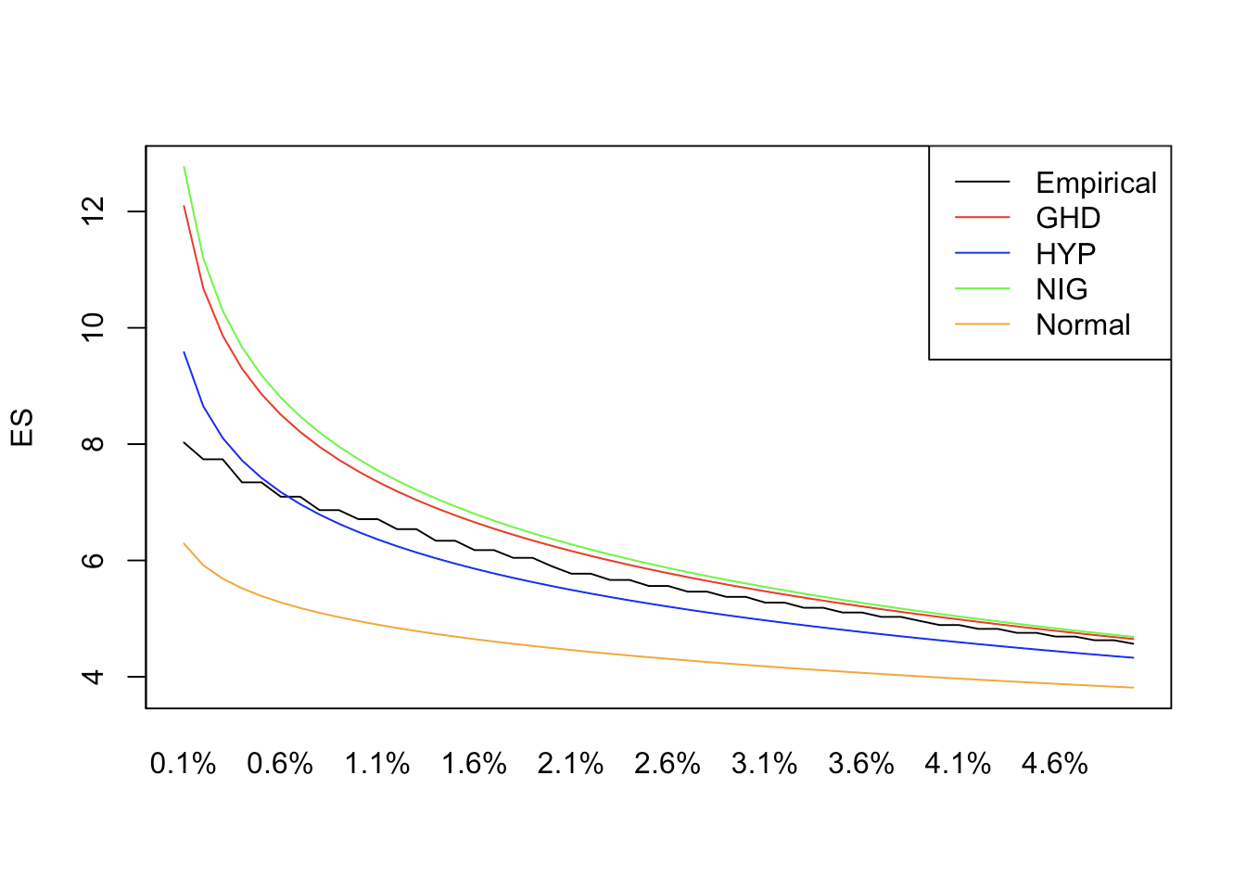
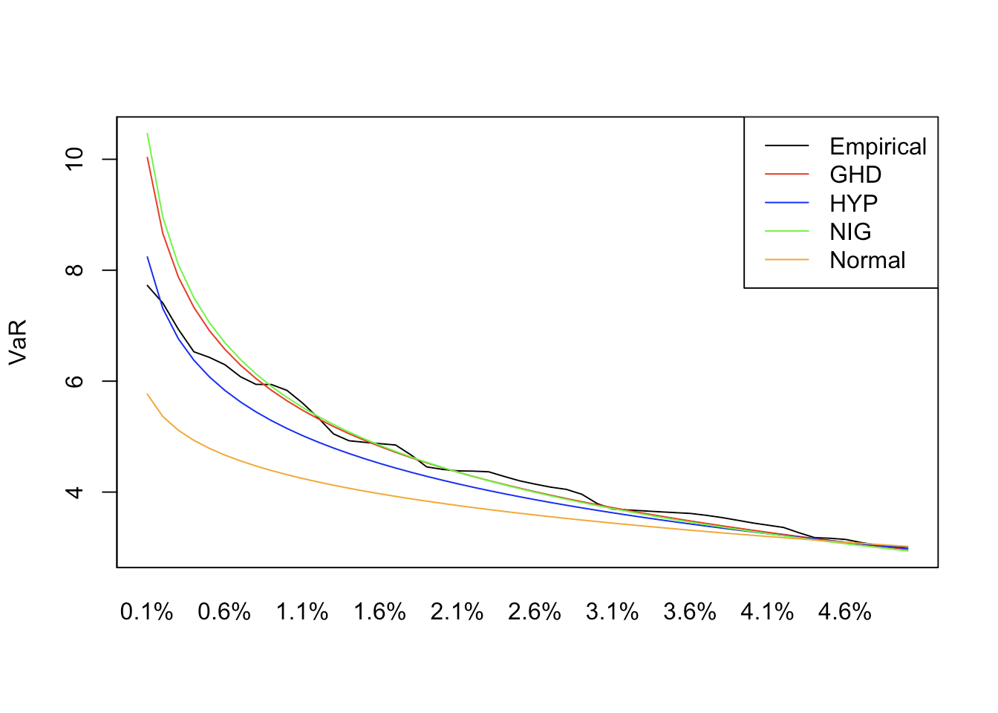
VaR and Expected Shortfall
Once we had our equally weighted portfolio return fitted with the distribution, we also wanted to capture to more important risk metrics:
Value-at-Risk (VaR): measures the loss or downside risk of the portfolio, and
Expected Shortfall (tail VaR): which tells us the expected return in the worst of cases, hence it is also called tail VaR.
Additionally, since we had an economic event included in our observation period, hence we did not use the extreme value theory to introduce more anomaly behavior in our data.

Slide 9
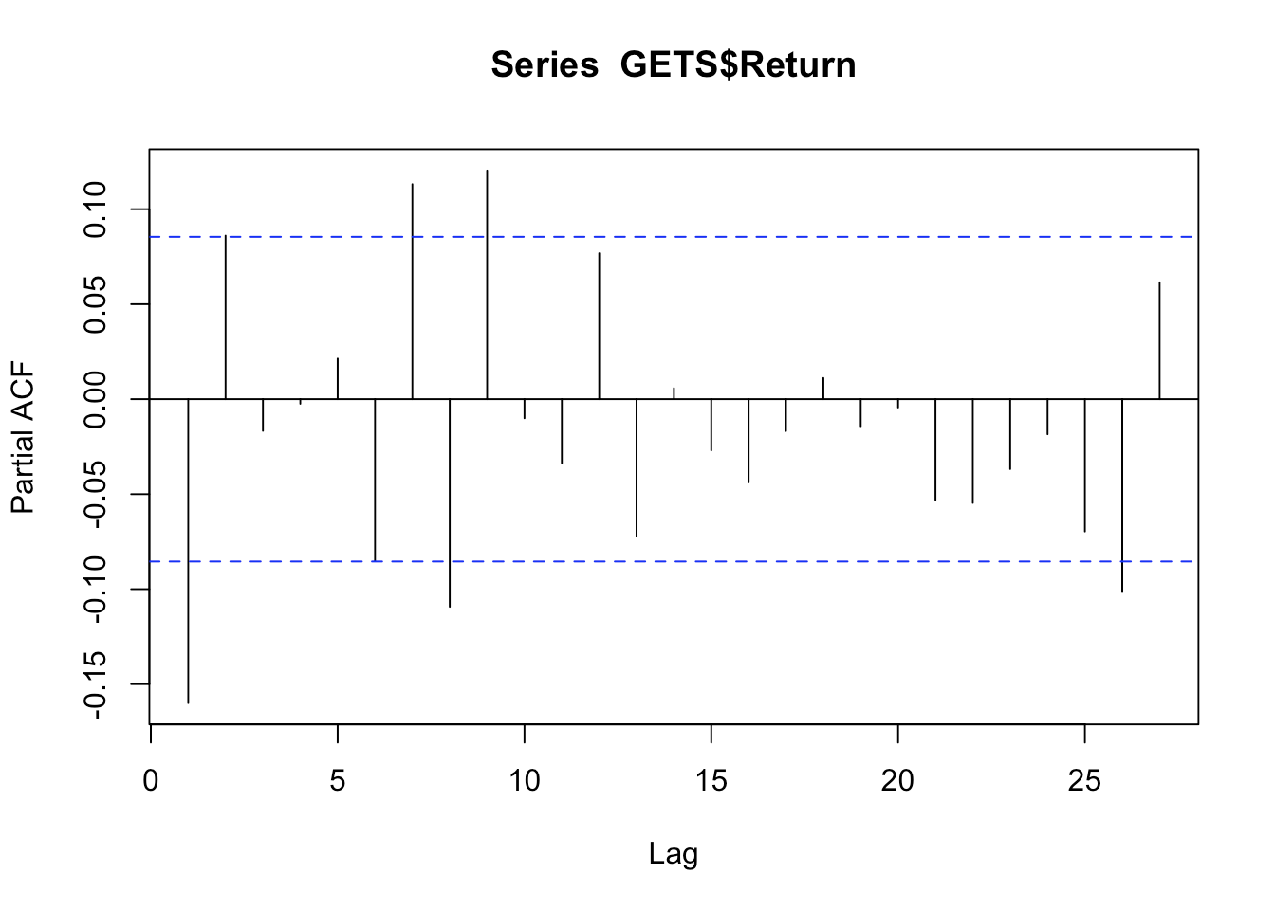
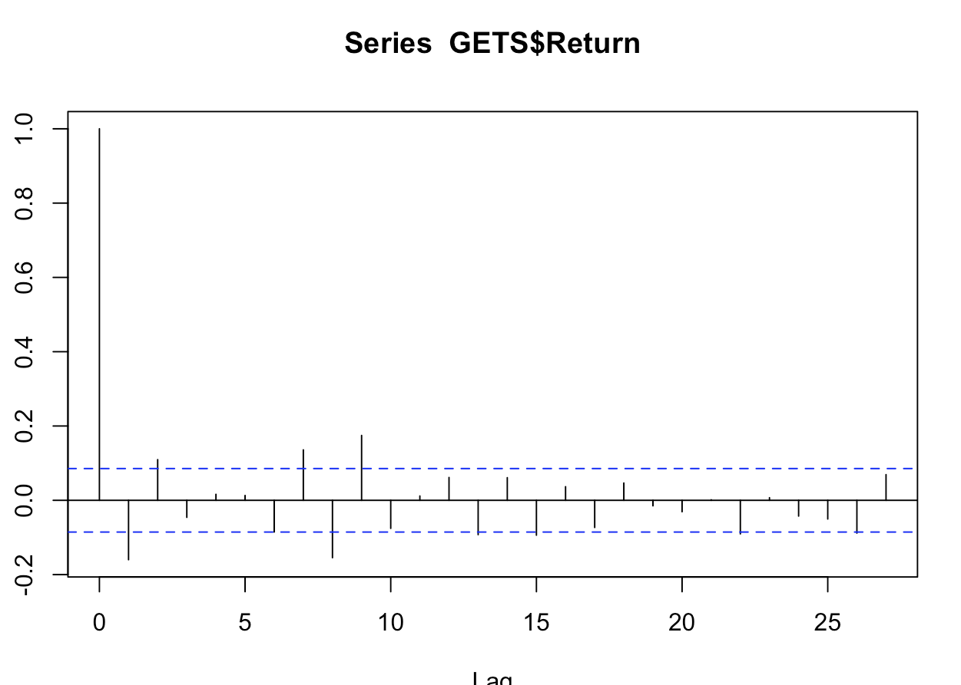
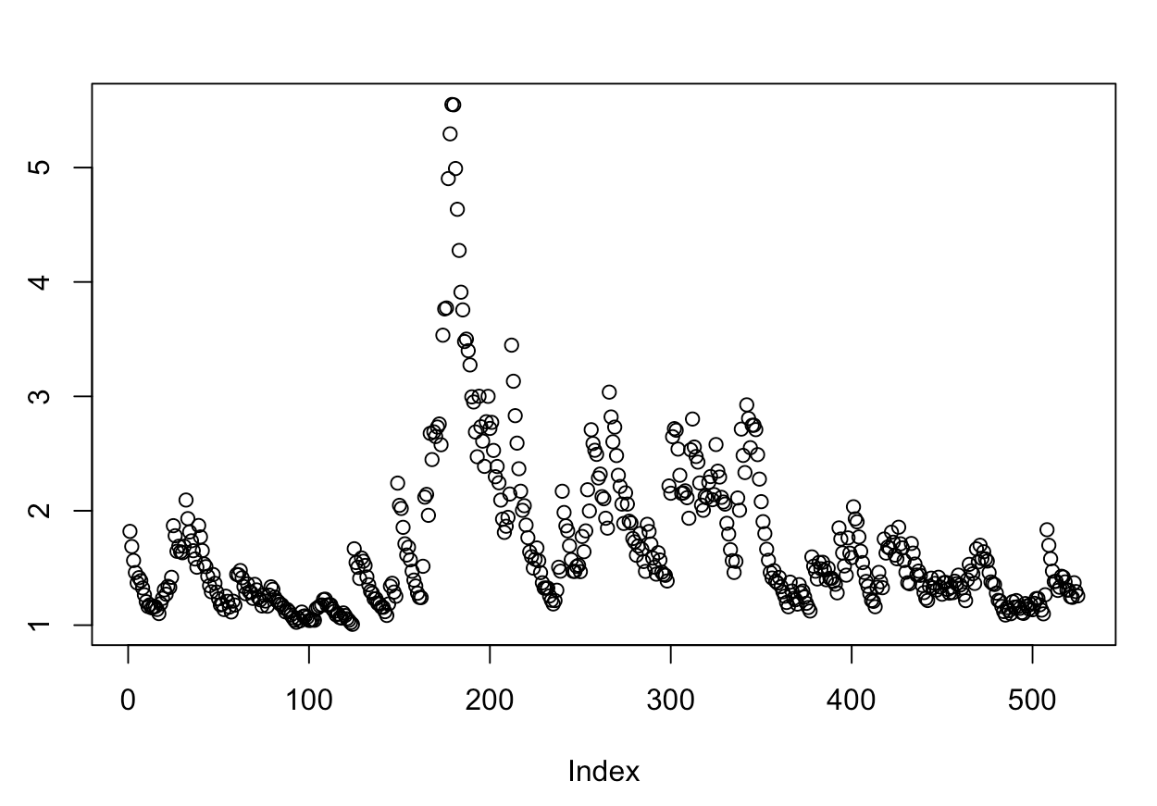
GARCH model
For this project we have used the GARCH model to predict the volatility in the stock prices included in our portfolio.
GARCH differs from the ARCH model in the inclusion of lagged endogenous variables in the variance equation—that is, now the conditional variance depends not only on past squared errors but also on lagged conditional variances
We created a plot for autocorrelation and partial autocorrelation for our portfolio return, which tells us the influence of previous values on the current value.

Slide 10
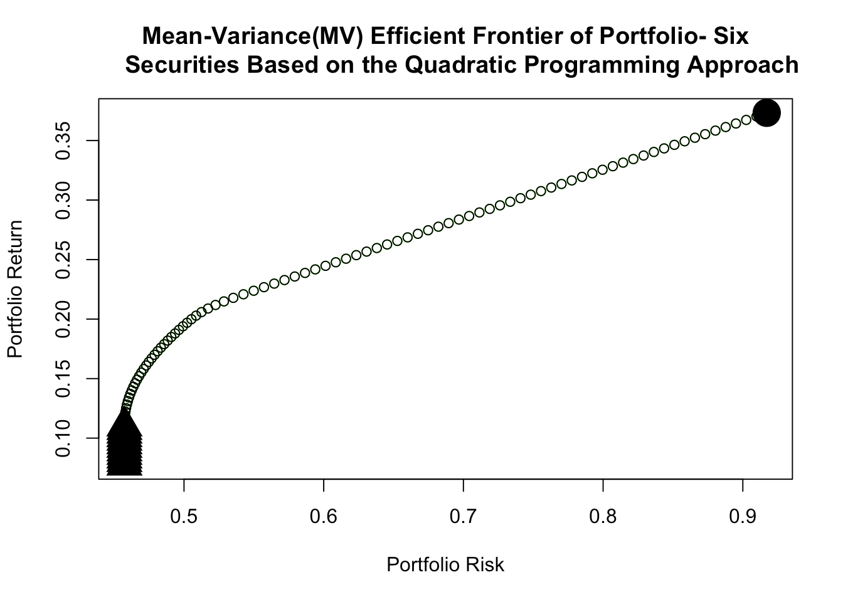
Markovitz Mean Variance frontier
In this slide, we are showing the Mean-variance efficient frontier of our portfolio, where this approach shows that by properly diversifying a portfolio, it is possible to reduce the risk of the entire portfolio from that of the weighted-average risk of the assets that make up the portfolio.
We have used the quadratic programming because the objective is to use a quadratic function for optimization. A quadratic function includes a variable (in this case weight) that is squared. This was selected because Quadratic programming finds the combination of securities that yield the minimum risk for a specific level of return.

Slide 11
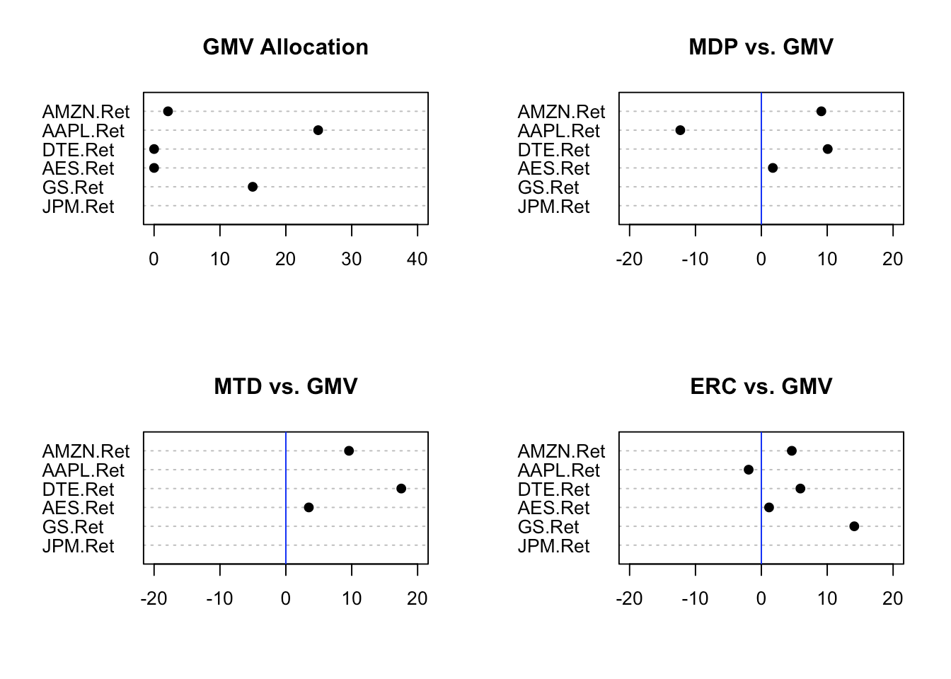
Comparison of portfolio diversification using all our underlying stocks
Diversification entails at least two dimensions.
The first dimension addresses the question of the underlying common characteristic with respect to which the assets are diverse.
The second addresses the question of how to measure the degree of diversification with respect to this characteristic.
The four portfolios we have used to see our diversification effect are:
The global-minimum variance portfolio.
The most diversified Portfolio,
The equal-risk contributied Portfolio
Minimum tail-dependent portfolio
 | GMVw | MDPw | MTDw | ERCw
SD | 2.28 | 4.362 | 5.775 | 3.354
ES95 | 1.00 | 1.000 | 1.000 | 1.000
DR | 1.81 | 2.343 | 2.257 | 2.264
CR | 0.29 | 0.219 | 0.236 | 0.175

Slide 12
Conclusion
The aim for us from this project was to create an algorithm, however, we have also observed that,
Pandemic did not had an extreme adverse effect on stock market as credit crisis of 2008.
Even though no analysis was conducted in selecting our stocks, Technology and Finance did perform well before, during and after the pandemic period as assessed by the $1 investment done in observation period.
In order to create an efficient portfolio, if the user is more risk-averse than the author, they may have to include a risk-free asset in the portfolio, since for this purpose we have only included and focussed on stocks as an asset in our portfolio.
Even with a straight forward approach in portfolio creation, we can still create a diversified portfolio with tools shown in the paper, if the purpose of the investor is to achieve higher return with minimal risk.

